Slide 1
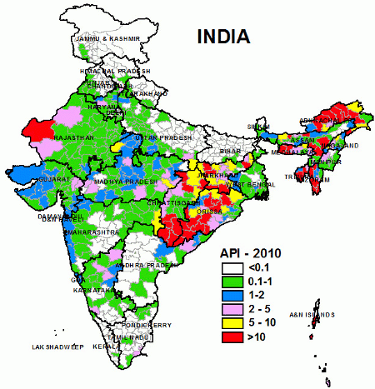
Malaria in India
Student’s Name
Institution

Slide 2
Malaria
Malaria is a disease transmitted through mosquitoes that are infected.
Some areas are more prone to the disease than others.
With proper measures, malaria can be preventable and cured with the appropriate drugs.
The symptoms of the disease include fever and nausea.
The disease kills more people compared to other infectious diseases.
Apart from humans, malaria also affects some animals.
Notes:
Malaria is a life threatening disease if not properly managed.
The parasites transmit the disease through bites.
The signs and symptoms can be detected as soon as seven days after the bite.

Slide 3
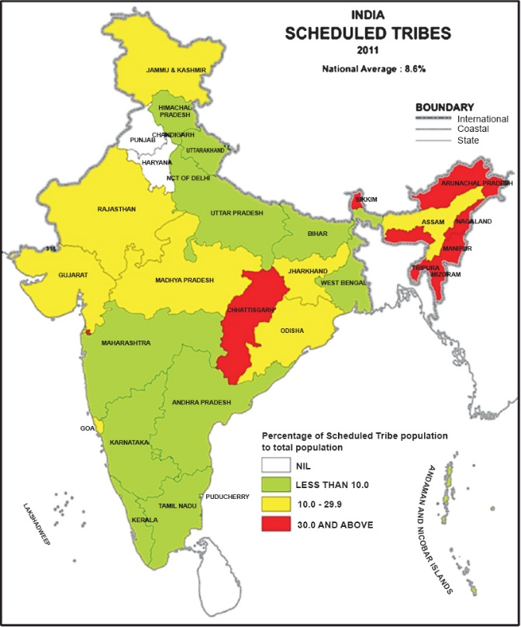
High Risk of Malaria in India
Indians have been at high risk of getting infected with malaria for many centuries.
India is the second country with high malaria cases in the world.
Reports indicate that a quarter of Indian’s population resides in high transmission locations.
The World Malaria Report in 2016 stated that more than half of the total population in India was facing the threat of contracting the disease (Anvikar et al., 2016, p108)
The disease has been increasing the economic burden in the country due to reduced wages.
.
Notes:
Absenteeism at work lead to the low wages and loss of jobs.
The poor are at high risk of contracting the disease.
Malaria control is cheaper than treatment.

Slide 4
Individual and family issues
There are specific individual factors that contribute to the high risk of malaria.
Results of a study in India proved that half of the affected individuals were women.
Hygiene is crucial in preventing malaria.
Leaving stagnated dirty water around the houses create breeding areas for mosquitoes.
Family roles and structure also affect the transmission of the disease, and children are mostly affected (Venkatesh et al., 2016, p353)
Households with many family members are likely to contract malaria more than those with few individuals.
Notes:
Personal hygiene includes cleanliness in the houses to ensure that no stagnant water is left within the houses.
Families with low income earners are at high risk due to lack of enough money for preventive measures.
Families with young children are required to take precautions to protect children below five years of age

Slide 5
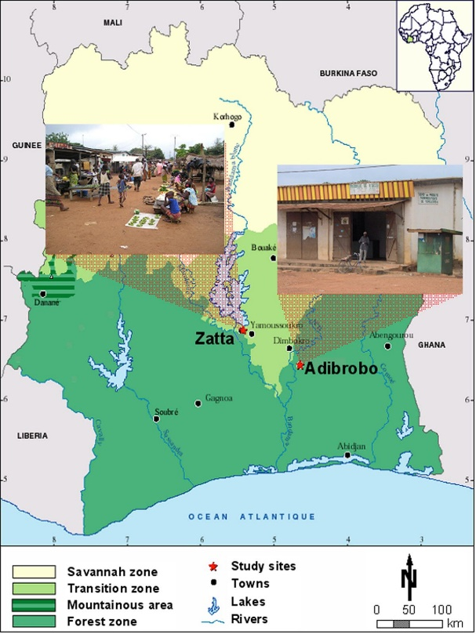
Community and Cultural Issues
.
Community factors determine the spread of malaria.
A study conducted in India stated that the majority of citizens who depended on traditional methods of treatment-experienced high death rates.
Communities located in marginalized areas have fewer opportunities for benefiting from government preventive programs (Mishra et al., 2015, p1)
Malaria parasites spread the disease mostly in less densely populated areas.
Some communities with beliefs that prohibit them from accessing medical attention record high number of malaria deaths.
Notes:
The cultural practices of malaria treatment determine the success of cure
When drugs are available at community levels, few cases of illnesses are reported.
Community based organization play a key role in educating the public

Slide 6
Environmental issues
In India, Malaria cases were more in less populated rural areas.
Recently, the parasites have adapted to the conditions of the Urban area
The condition of the environment is a determinant of the level of risk associated with malaria.
People located close to densely vegetated areas, and water bodies are at high risk of contracting malaria (Gomes et al., 2017, p1887)
Areas that receive rainfall frequently have swampy areas the create sites for mosquitoes.
Notes:
Areas with blocked drainage systems expose residents to the risk of Malaria
Locations with poor drainage systems create breeding sites for mosquito
In India, most areas are prone to high temperatures which is a favorable condition for breeding

Slide 7
Factors Accelerating the Illness
Poor drainage is the leading environmental factor that increases malaria spreading in India
Poor quality of medical care at community levels in some areas in India lead to increased motility rate of malaria cases.
Low income makes it difficult for affected individuals to access treatment.
The risks are high for women and children due to the low immunity system.
Notes:
Dehli in India is prone to malaria due to favorable climatic factors for mosquito breeding.
Deforestation in some areas in India contributes to the rise of malaria cases
Social cultural factors related to access of medical care expose make some communities more vulnerable.

Slide 8
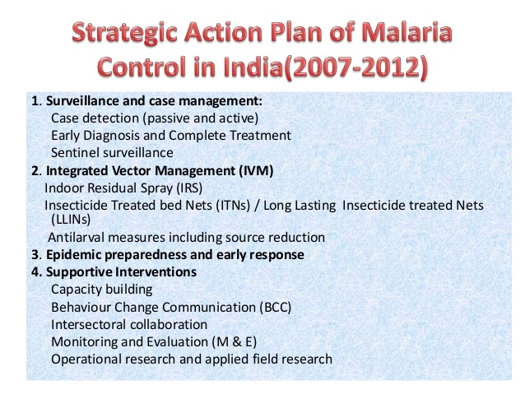
Action Plan
In India, the National Vector Borne Disease Control Programe has the mandate to control Malaria.
The government funds the program to meet the set goals.
The government released a strategic plan to eradicate malaria in India by 2030 (World Health Organization, 2018).
The government has been allocating funds for free preventive measures.
The government should create more community-based programs to educate the public about preventive measures.
.
Notes:
The government has the key role in creating malarial awareness
Prevention of malaria requires a few measures and money than the treatment process
The program managers should utilize the provided funds efficiently to achieve the goals.

Slide 9
References
Anvikar, A. R., Shah, N., Dhariwal, A. C., Sonal, G. S., Pradhan, M. M., Ghosh, S. K., & Valecha, N. (2016). Epidemiology of Plasmodium vivax malaria in India. The American journal of tropical medicine and hygiene, 95(6_Suppl), 108-120.
Gomes, M., Begum, R., Sati, P., Dikshit, R., Gupta, P. C., Kumar, R., ... & Jha, P. (2017). Nationwide mortality studies to quantify causes of death: relevant lessons from India’s million death study. Health Affairs, 36(11), 1887-1895.
World Health Organization. (2018). Malaria: From declaration to action, and intensifying dengue vector control (No. SEA/RC71/8). World Health Organization. Regional Office for South-East Asia.
Mishra, S., Kusuma, Y. S., & Babu, B. V. (2015). Migration and health-care access: barriers to access government health services by migrant tribal community living in an eastern Indian city. Int J Med Sci Public Health, 4(1), 1.
Venkatesh, V., Rai, A., Sykes, T. A., & Aljafari, R. (2016). Combating Infant Mortality in Rural India: Evidence from a Field Study of eHealth Kiosk Imlementations. Mis Quarterly, 40(2), 353-380.

